Slide 1
Great Places to Visit and Invest
Karoly Burgyan
Shayla Badeaux
Christian Cantu
Notes:
Great Destinations
Great Places to Visit and Invest
Prime country candidates for investment

Slide 2

Questions
Is there a correlation between Happiness and Safety?
Is there a correlation between Happiness and Cost of Living?
Is there a correlation between Happiness and Purchasing Power?
Which countries satisfy the priorities of the customer best-- does the customer value happiness, purchasing power, or safety most?
Which countries on the priority lists have the most developed infrastructure using GDP as a proxy for infrastructure development?
Notes:
During brainstorming, we stumbled on the Happiness database, and it sparked our curiosity. What is happiness correlated to?
<Read out questions. 1-3>
Who would be interested in this information? It depends on your priorities.
<Read question 4 and 5>

Slide 3
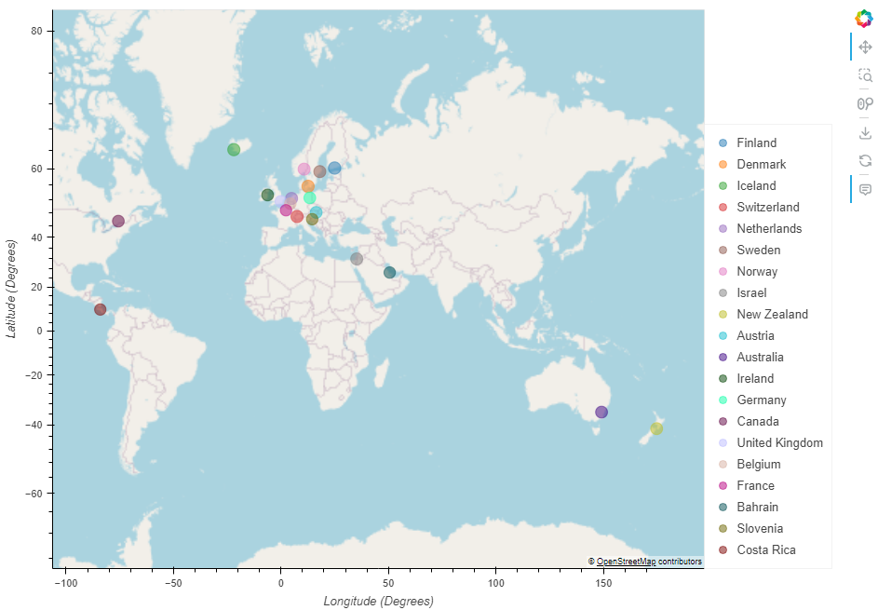
Top 20 Happiest Countries
Notes:
In case you were wondering, like we were wondering, here the top 20 happiest countries from our data.
For example…
<(Here we imagined a US based real estate or travel agency company that is about to go international)>

Slide 4
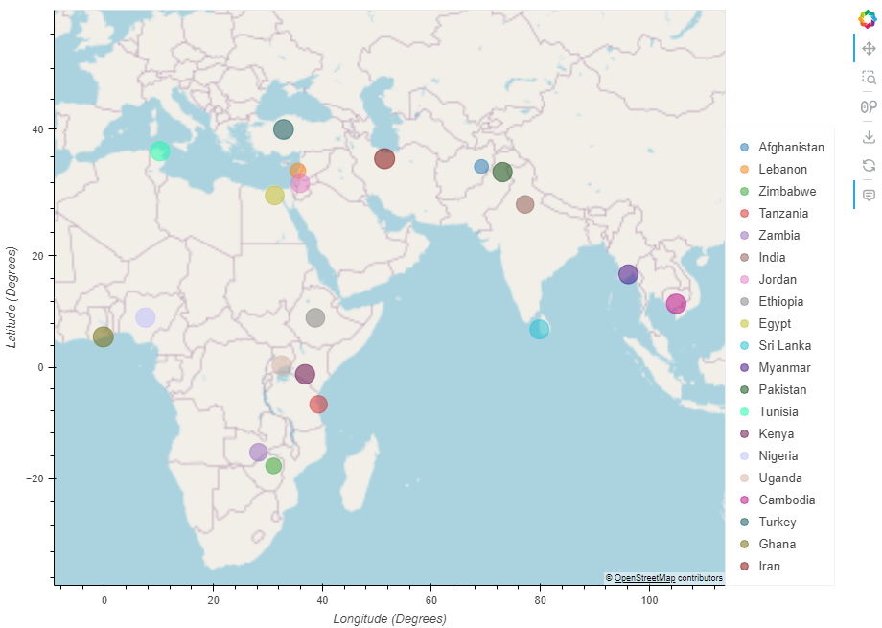
Bottom 20 Least happy Countries
Notes:
Also, in case you wondering, here’s the bottom 20 happiest countries, according to our database.
(This could be relevant to any do-gooders out there, who want to make the world a happier place)
Ok, now back to our questions about correlations to happiness

Slide 5
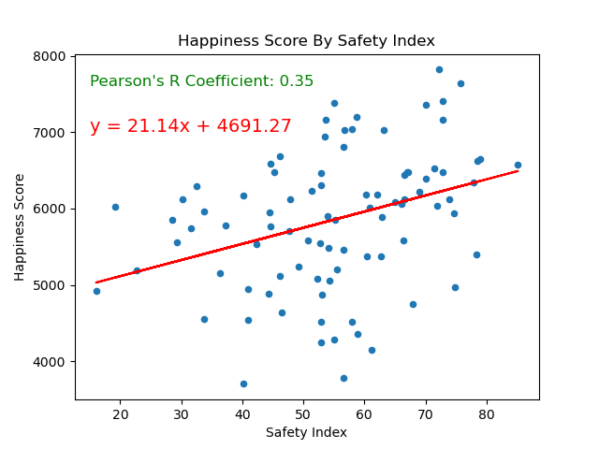
Notes:
We started out with plotting Happiness vs Safety.
As you can see, we have a positive correlation, as shown by the r value of 0.44 as well as the regression line.
And that of course makes sense because, there is a psychological correlation behind being safe and the feeling of being in a happy place.
(security and happiness go hand in hand)

Slide 6
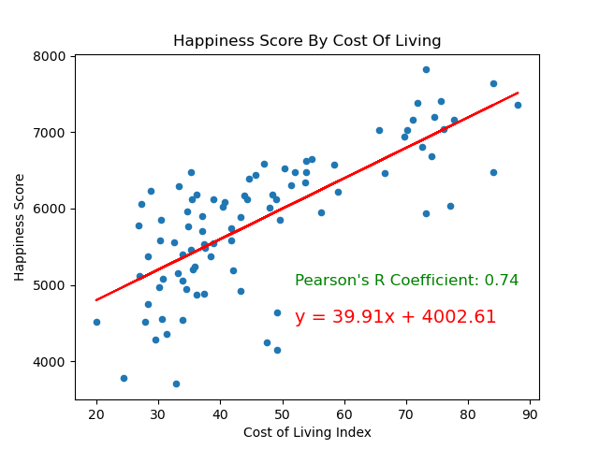
Notes:
Here we show the plot of the Happiness score over the Cost-of-Living Index.
It is more positively correlated as seen by the R value and regression line, compared to that of the Safety Index.
We can presume at this time that Cost of Living is a rough(very crude) proximation to salaries and social services which generally correlates to a more comfortable and happy living.

Slide 7
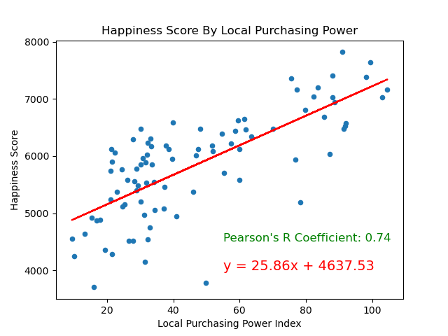
Notes:
If your cost of living is high, then it might be due to an increase in security costs.
And that is one of the reasons why we focused in on Purchasing Power.
Also, we are looking at it from the perspective of a travel agency and they would want to know how far their client's money would go.
As for a real estate company, they could purchase more property and they would attract more buyers.
As you can see the correlation (r value) is stronger between local purchasing power and happiness.

Slide 8
Happiness
Safety
Purchasing Power
Are Happiness, Safety, and Purchasing Power varying enough, across countries, to be interesting to investigate any further?

Slide 9
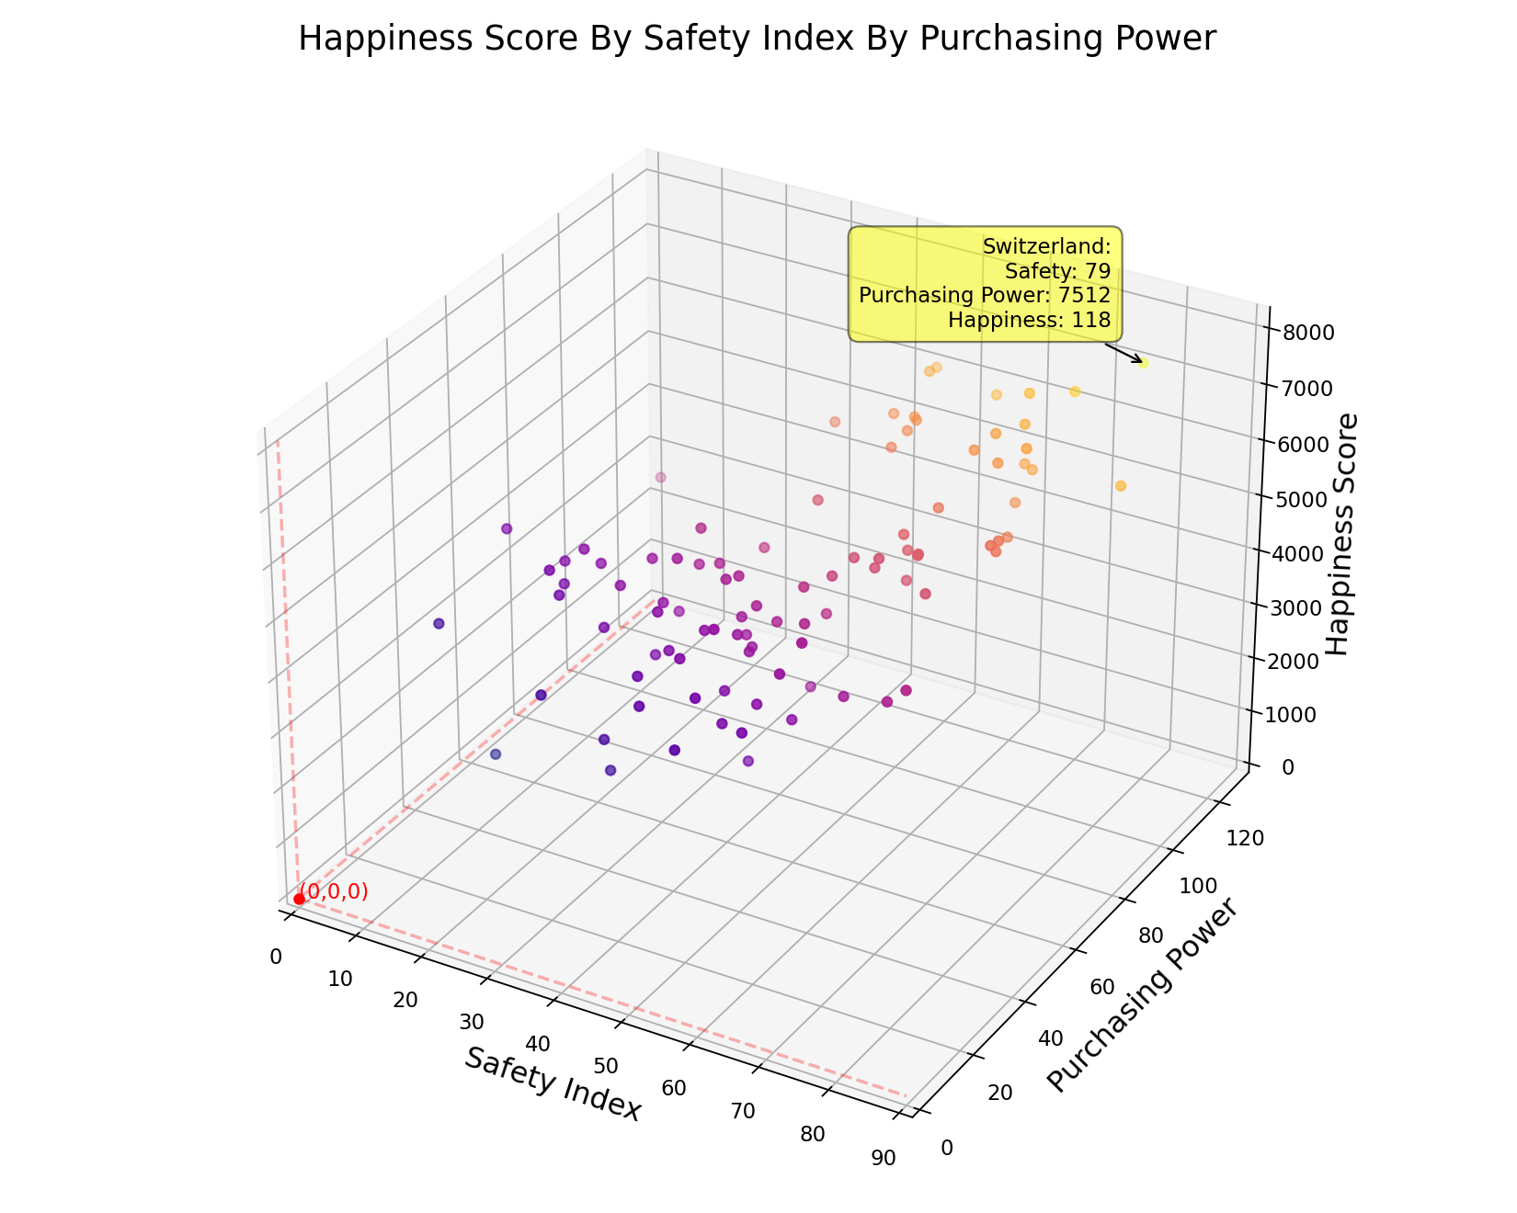
Notes:
So, here’s our starting point. This is the data being graphed from our database, being graphed so far.
This allowed us to get a first glimpse at what was going on with the dispersion of these different metrics.
<show the code/hover capabilities>
This allows us to investigate which points were standing out and if we should go any further.
Surprise, it became obvious that we should go further.
So, we decided to calculate the z-scores of the countries, to get a quantitative measure on just how divergent they are.

Slide 10
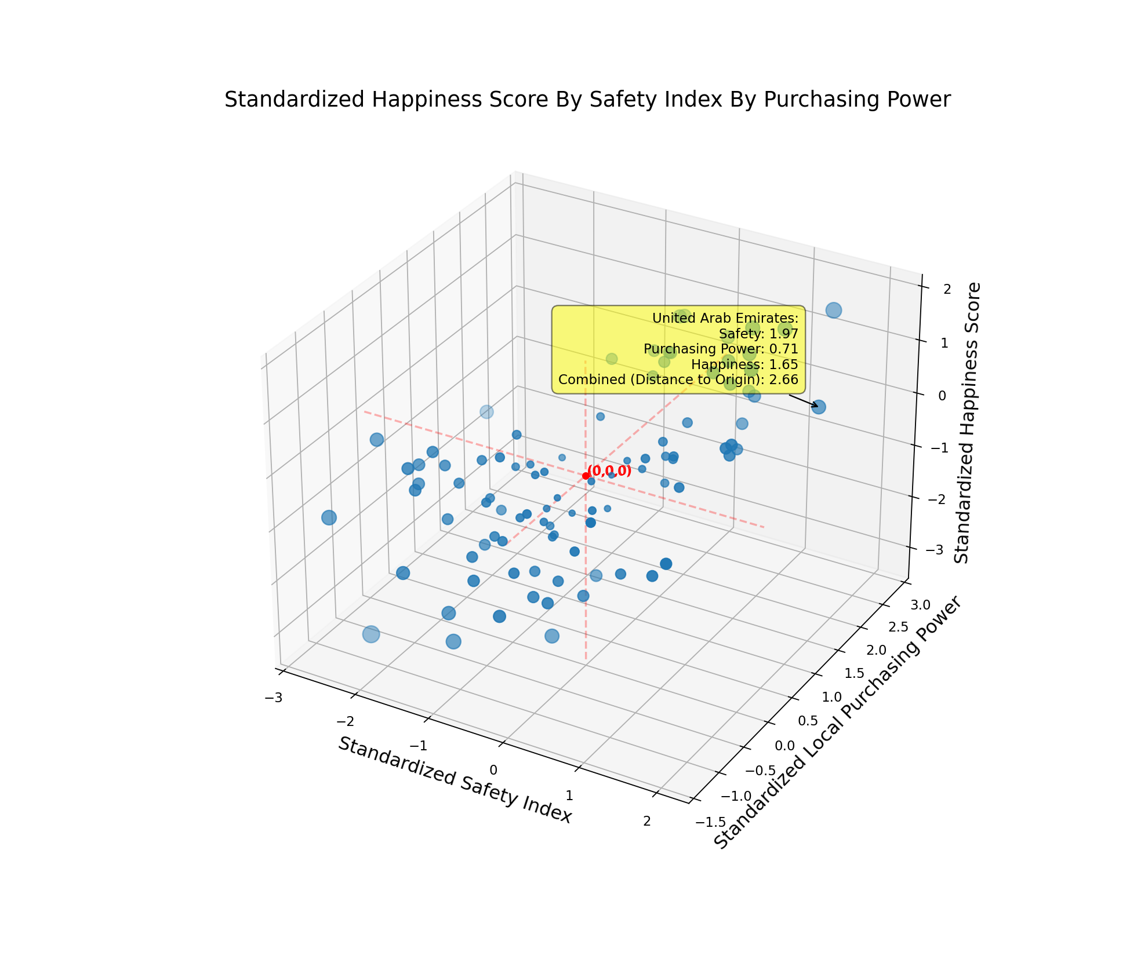
Notes:
So, here we can see that the origin is floating in the center of them.
And the size of the data point is proportional to both the distance from the origin and the combined z-score.
So, if all the categories were clustered around the mean, then we would know that it would have far less impact on where to invest or on where one would want to go on vacation
So now we can tell visually that they are significantly varying
As you can see there is great variation in these 3 metrics
<show 2 different hover points>
So now to make it more visually acute, we normalized the data so we could see it from a singular side.

Slide 11
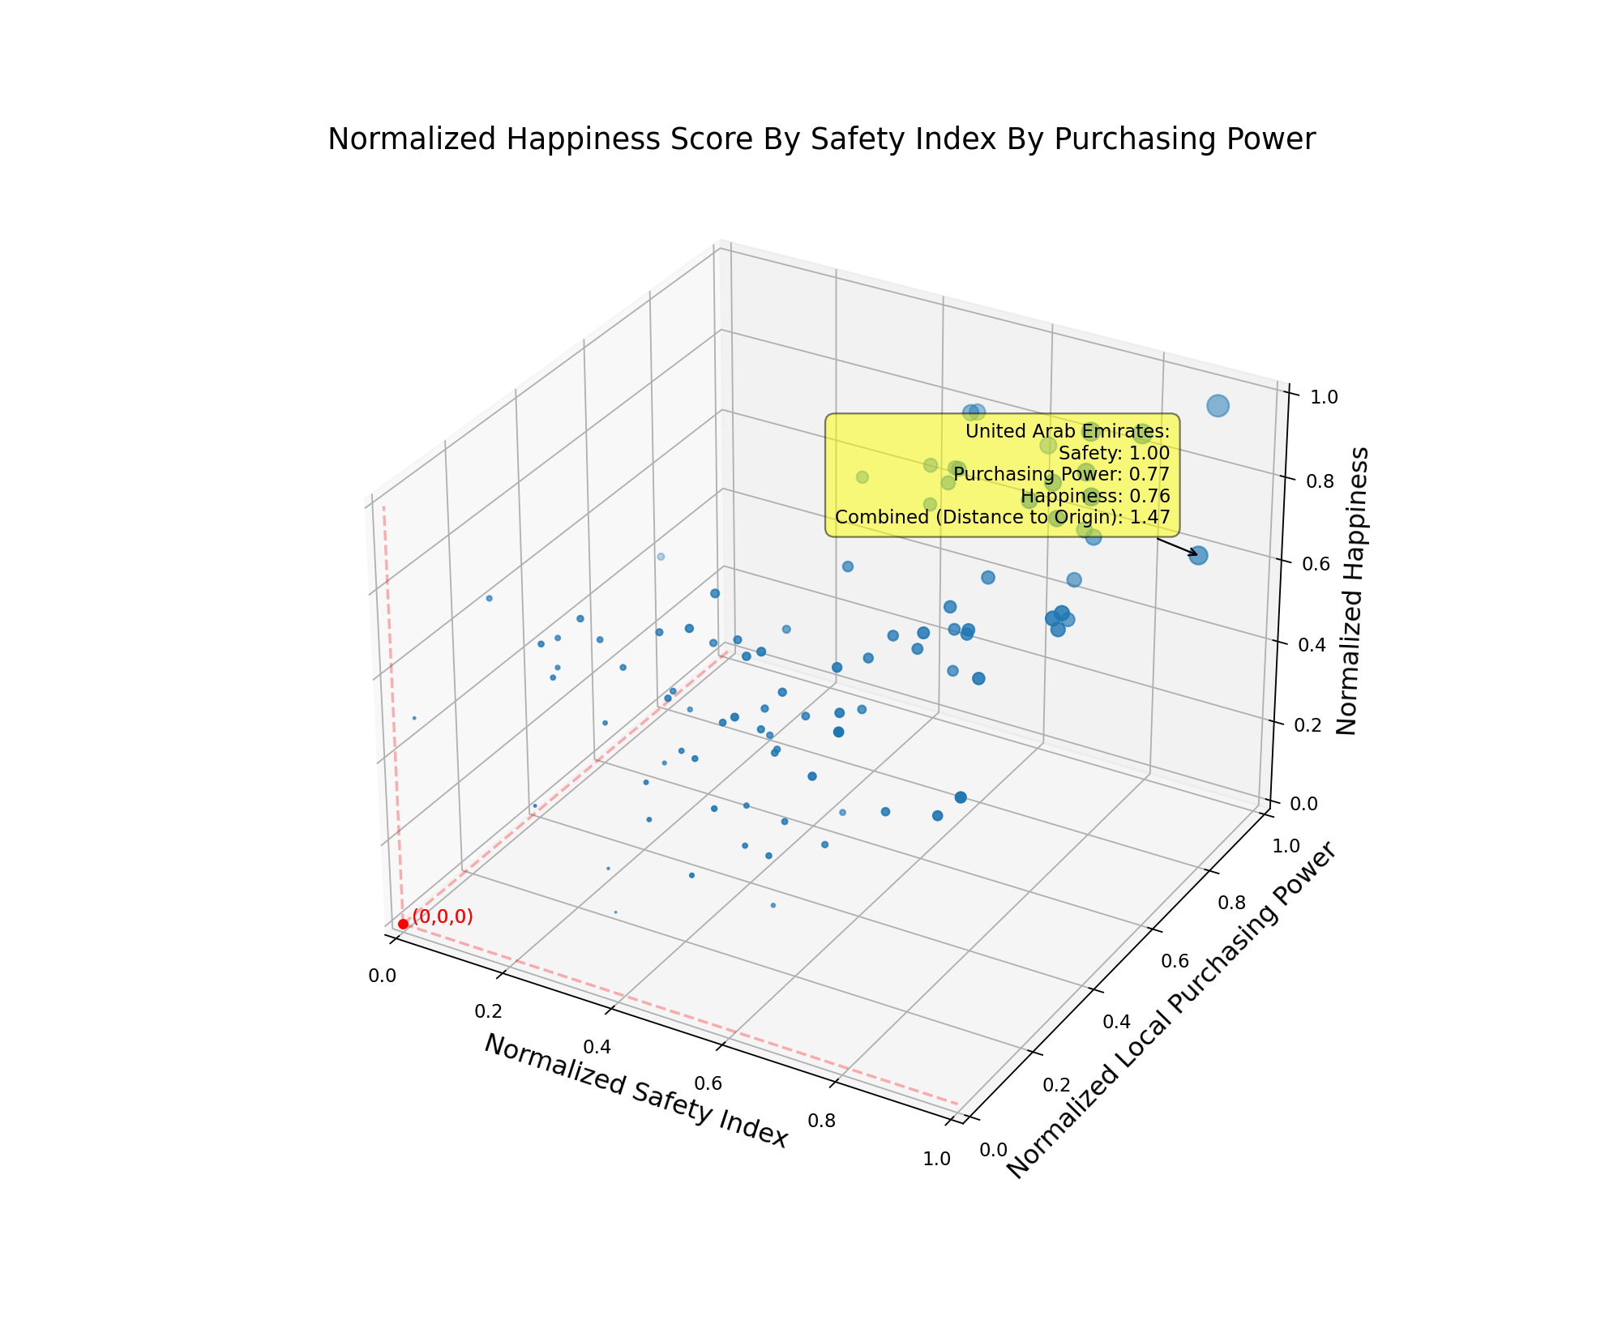
Notes:
Here we can see by combining all the metrics into one positive metric normalizing the data that they are extremely varying.
<show the 2 different hover points>
(So, we decided to normalize the scales
We also decided to reflect the distance from zero in the size of the points, so the farther from zero, the point is, the larger the radius.
We did this as more of an emphasis on the distance because we couldn’t rotate the figure.)

Slide 12
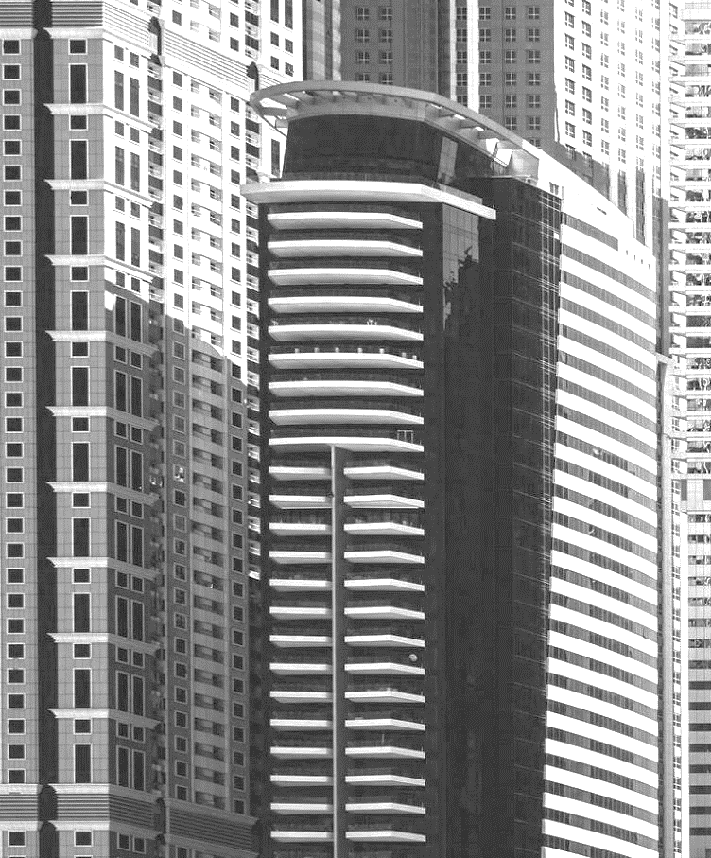

Countries of Consideration
Notes:
So, let’s take a look at the countries being considered.

Slide 13
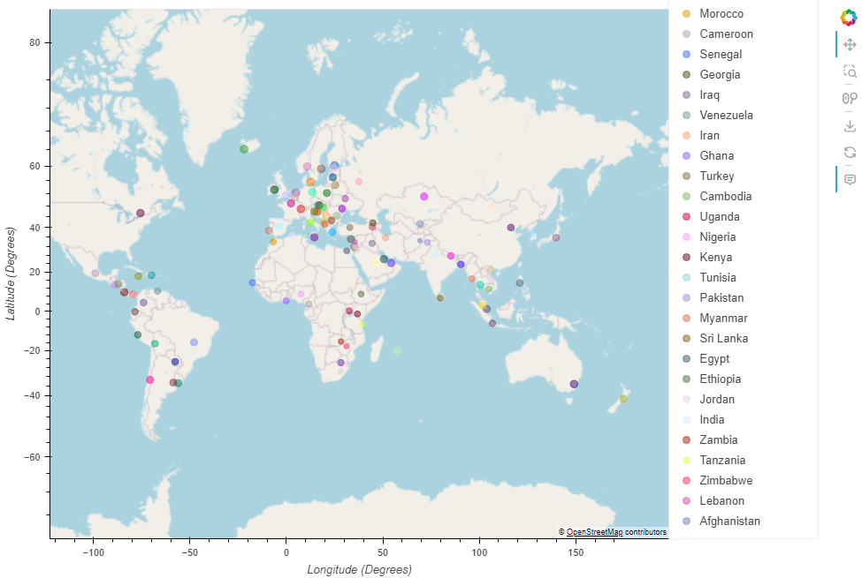
countries of considerations (Outside of US)
Notes:
Here we imagined a US based real estate or travel agency company that is about to go international. (in their investments)
Or a travel agency that would find this information useful.
We wanted to narrow it down in terms of countries of interest.
Here’s a plot of the capital cities of all the countries in our database.

Slide 14
Which countries satisfy the priorities of the customer best-- does the customer value happiness, purchasing power, or safety most?

Slide 15
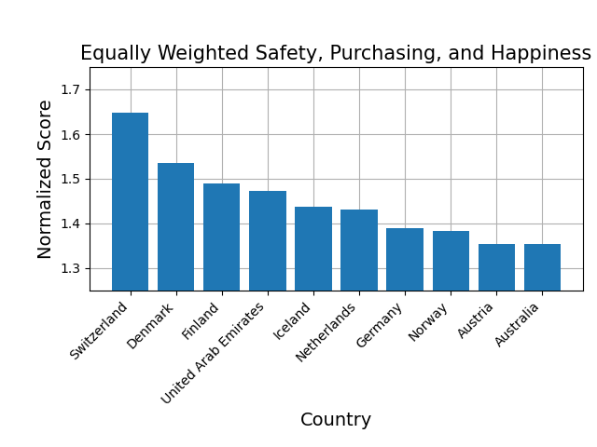
Notes:
Here we show an equal weight to all three priorities. (Happiness, Safety, and Purchasing)
Plotted the top 10 countries
Then, we were wondering if the list of the top 10 countries would be different if we gave different weights to these priorities

Slide 16
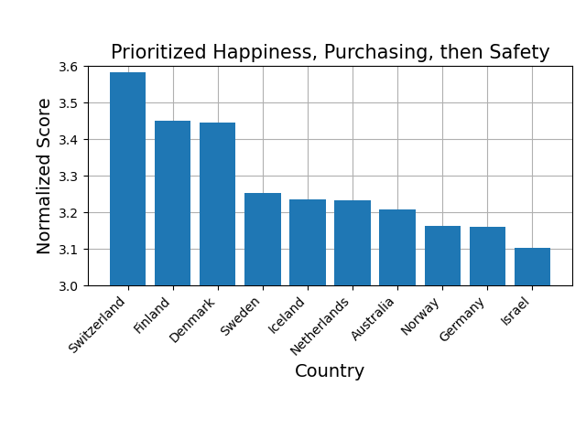
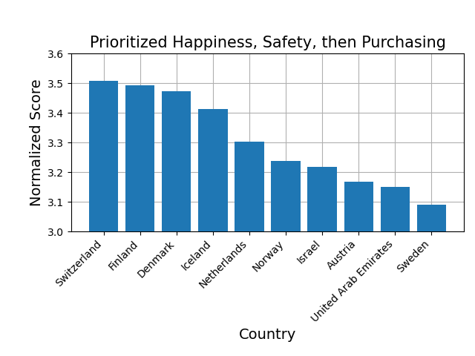
Prioritized Happiness Index
Notes:
Here Happiness has the highest weight of priority, in our equation.
In the first picture, happiness is given a weight of 3, purchasing a weight of 2, and safety a weight of 1
In the second plot, Safety, has a higher weight than Purchasing.
But ultimately, Happiness has the highest weight of the three priorities.
We could have shown a third plot, where Purchasing and Safety had the same weight, against a higher weight for Happiness.
For our purposes, we didn’t run these, in order to limit our list of potential list countries that we needed to zero in on.

Slide 17
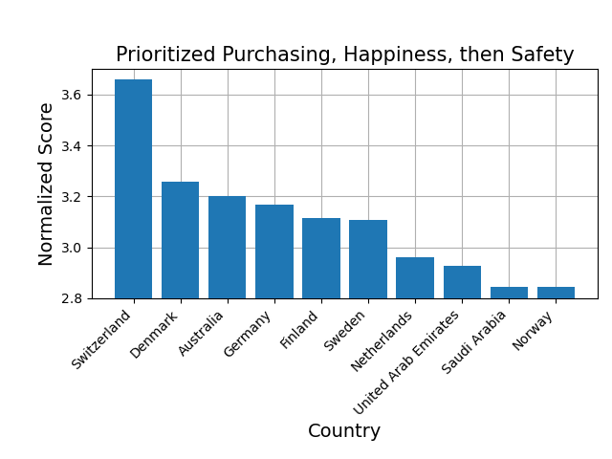
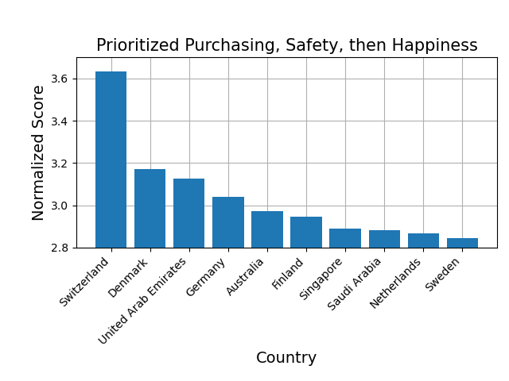
Prioritized Purchasing Power
Notes:
Here we have Purchasing as the top weighted priority against or other two factors.
As you can see there are only slight differences in the lists of countries and their order.

Slide 18
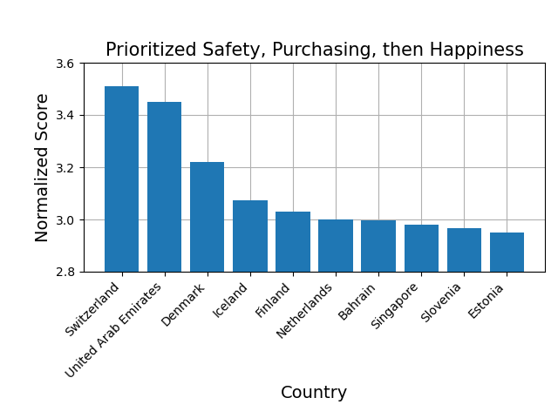
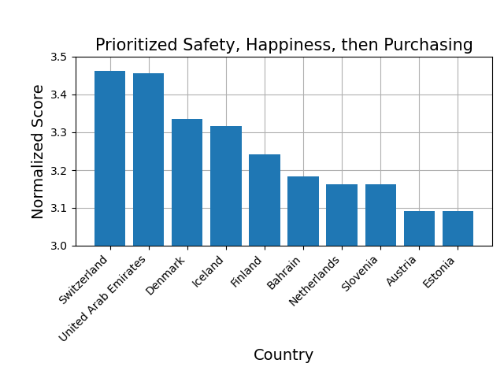
Prioritized Safety Index
Notes:
Here we have Safety as the highest weighted priority
Again, slightly different countries, and their order.
But it generally the same list.

Slide 19

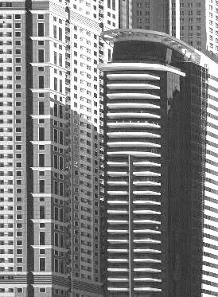


Which countries on the priority lists have the most developed infrastructure using GDP as a proxy for infrastructure development?
Notes:
<read question first>
So, as we ran our histograms, we gathered the country names, and added them to a set, so as not to get any duplicates, like you would in a list.

Slide 20
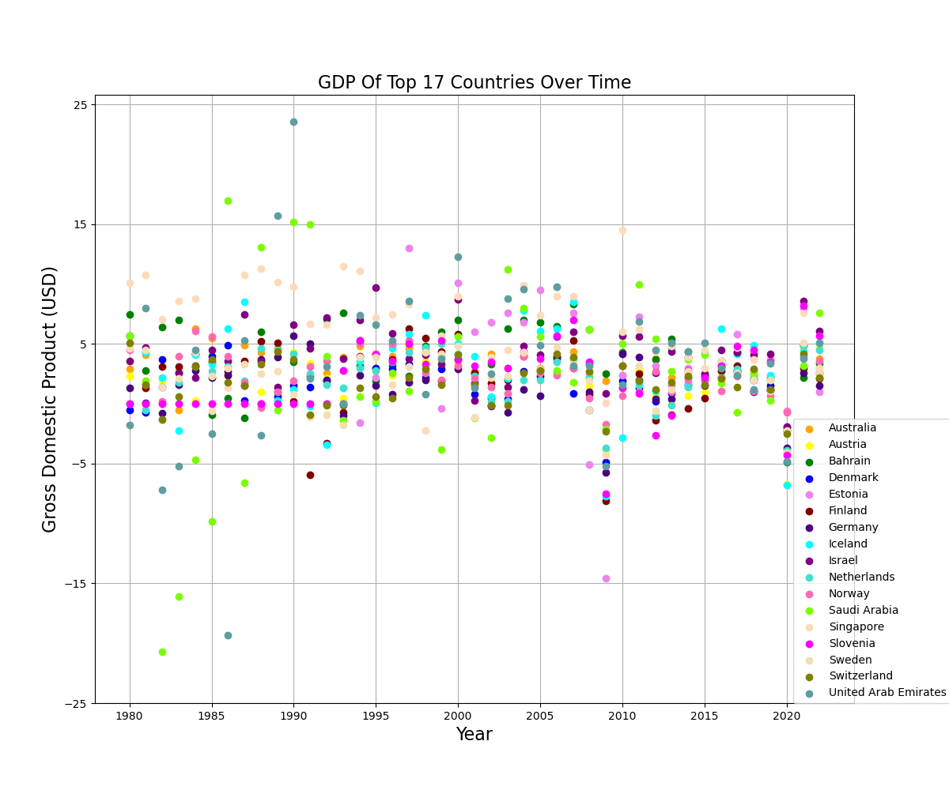
Notes:
We then used these countries and plotted their GDP growth or shrinkage over time. (GDP is presented as a % change from the previous year)
We thought this could show a good indication of the potential growth a real estate company could achieve with any investments.
It is also a good indication of infrastructure which is something the travel agency would be interested in knowing, so that their clients have amenities and such during their travels.

Slide 21
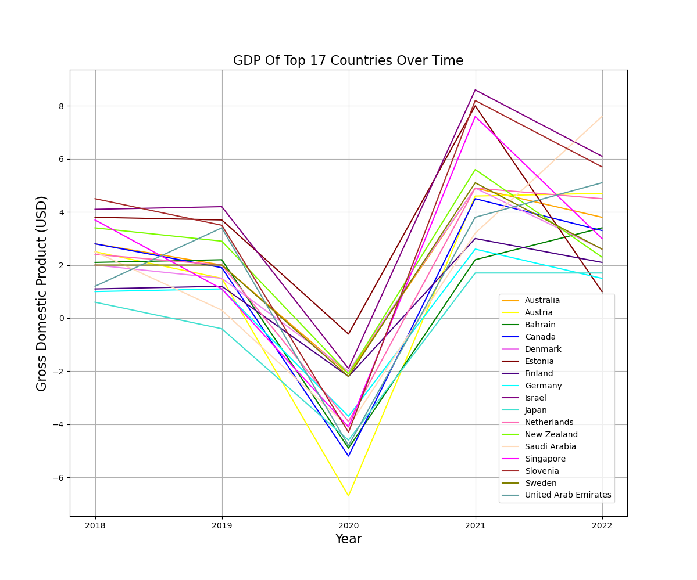
Notes:
(Let’s zoom in on the last 5 years…)

Slide 22
Next Steps real Estate
 | Narrow Data to Select Cities of Choice
 | Look into Population Trends of Selected Cities
 | Real Estate Trends in Cities (Competition)
 | Plot Infrastructure Close to Interested Areas
 | Research into Industries of Selected Cities
Notes:
There is still more analysis to do
So for Real Estate <read points>

Slide 23
Next Steps Travel Agency
 | Look into Exchange Rate Trends of Selected Countries
 | Research Tourist Attractions in Countries of Interest
 | Narrow Data to Select Cities of Choice
 | Plot Infrastructure Close to Interested Areas (Hotels, Restaurants, Parks, Bars, Hospitals)
 | Research into Flight Costs

Slide 24
Questions?

